Slide 1


Slide 3
Continued next page…

Slide 4
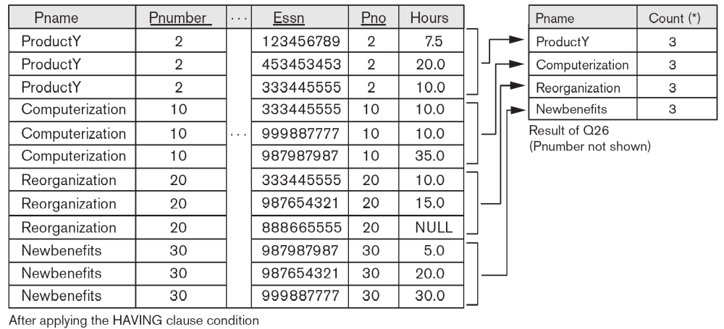

Slide 5
